Slide 1
CUSTOMER CHURN ANALYSIS
By
- Sachin B C
CAPSTONE PROJECT

Slide 2

Contents
Project Objective
Summary statistics of the dataset
﻿﻿Identify the outliers in the dataset
﻿﻿Identify the missing values and display the count
﻿﻿Data imputation
Tableau Dashboard

Slide 3

Project Objective
Analyse of the customer data of a North American bank and build an interactive dashboard using Tableau. Building a dashboard will involve analysing the data and presenting the results using appropriate charts/graphs.

Slide 4
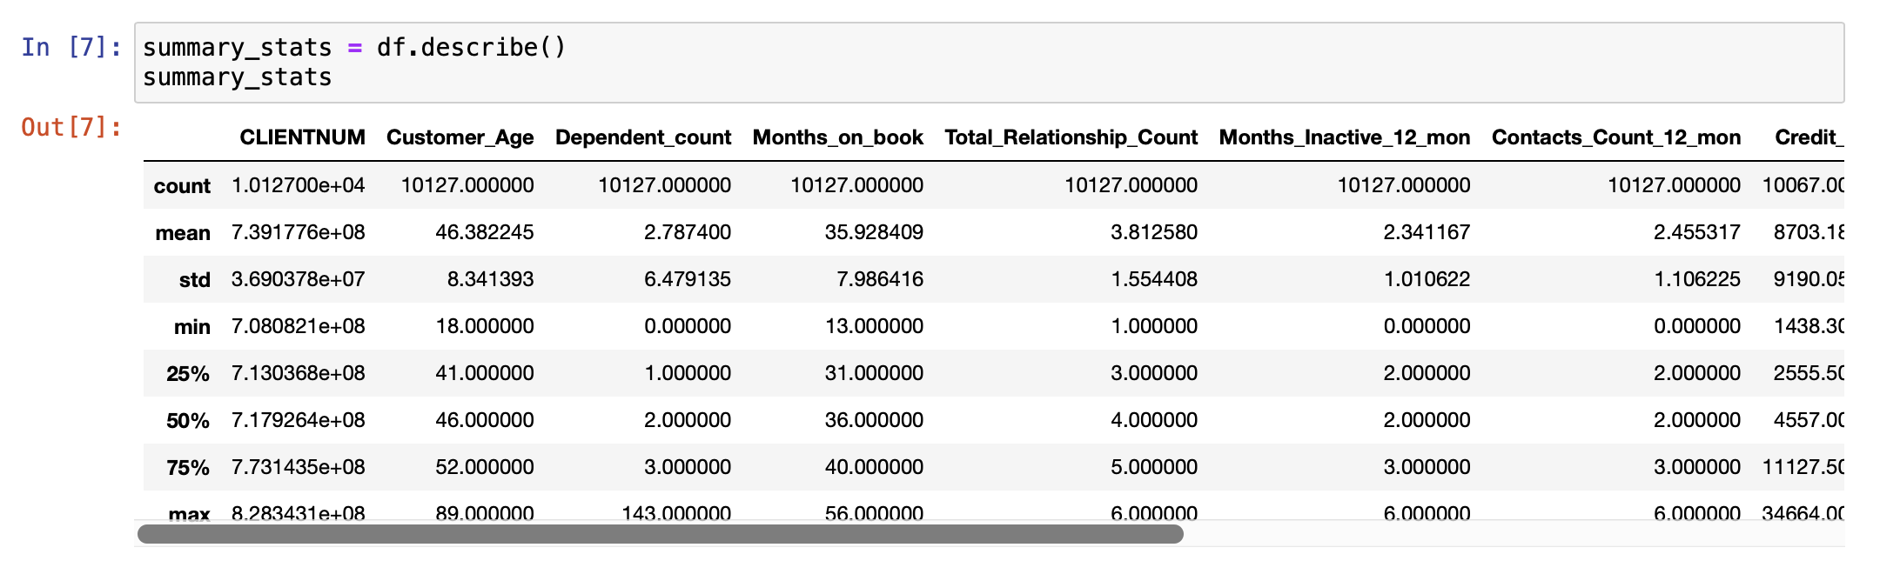
Summary statistics of the dataset ﻿﻿

Slide 5
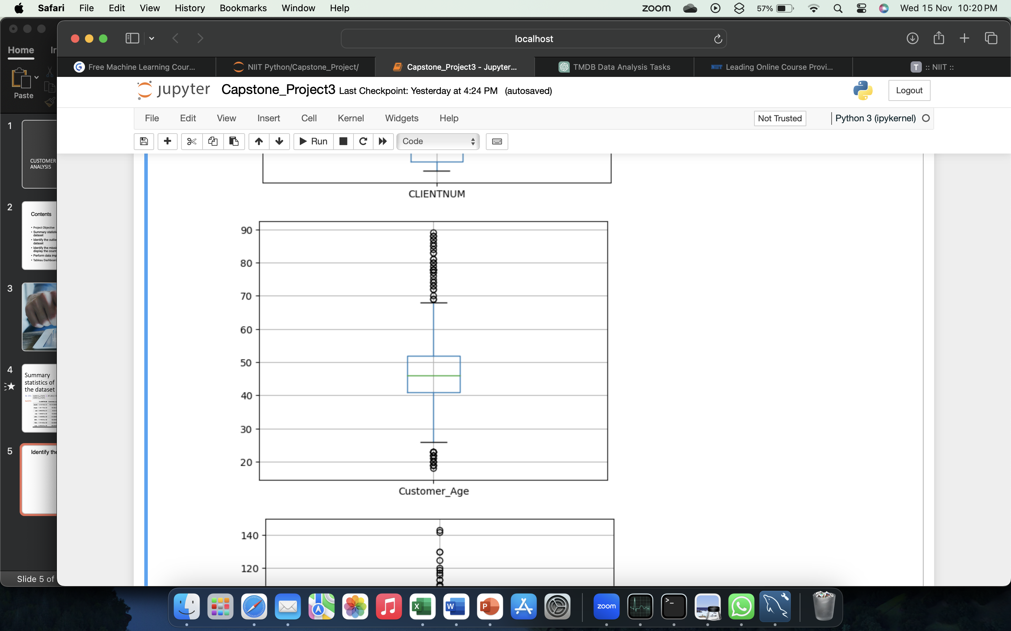
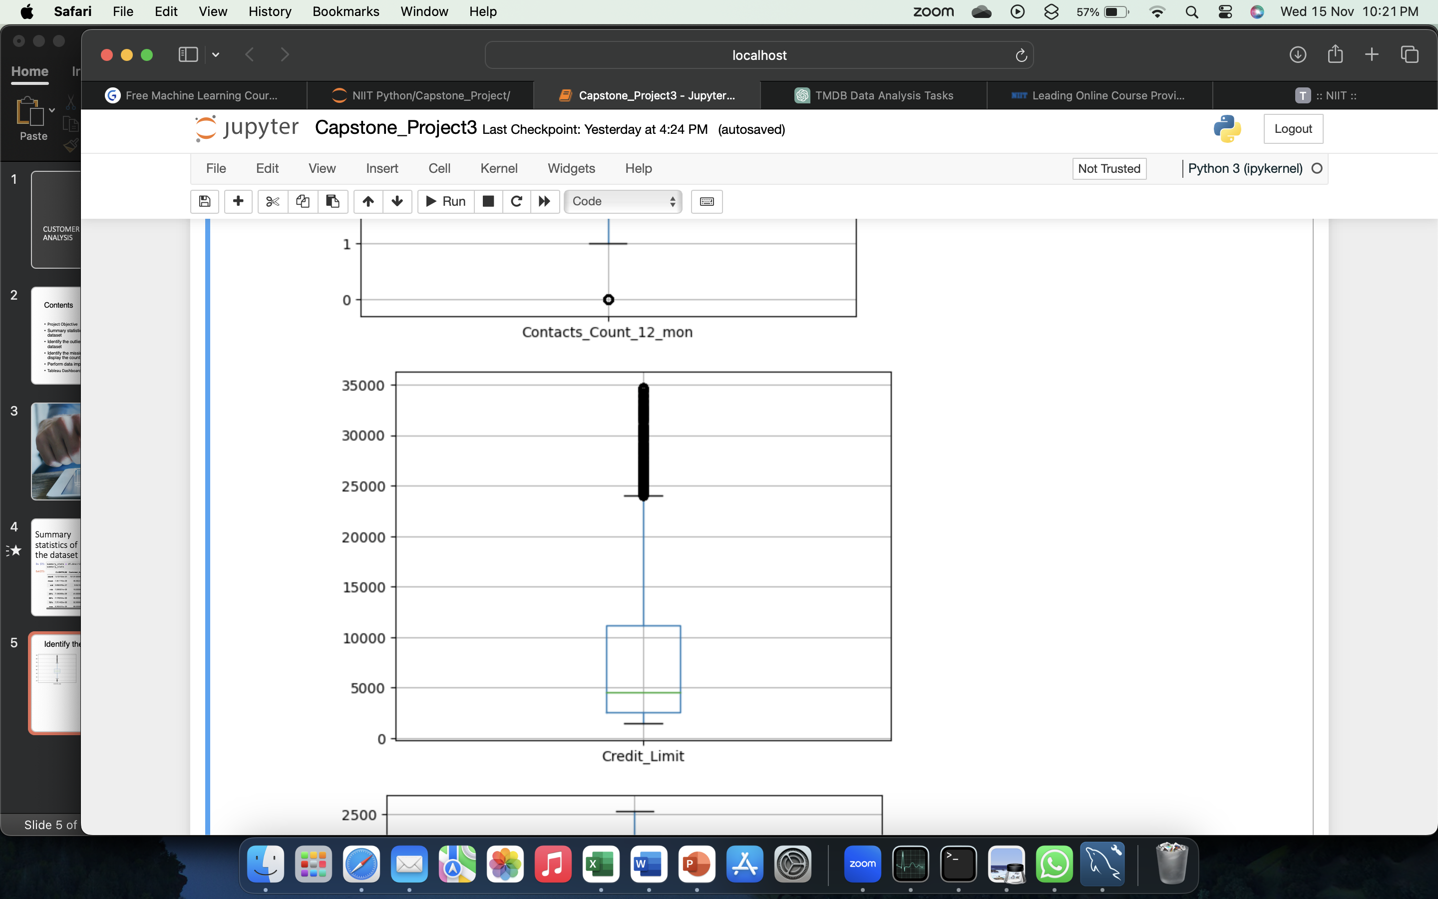
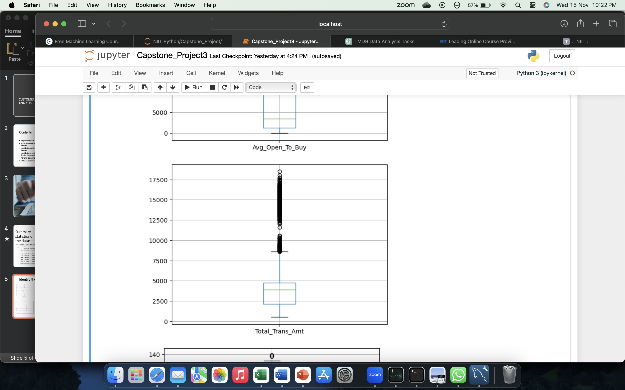

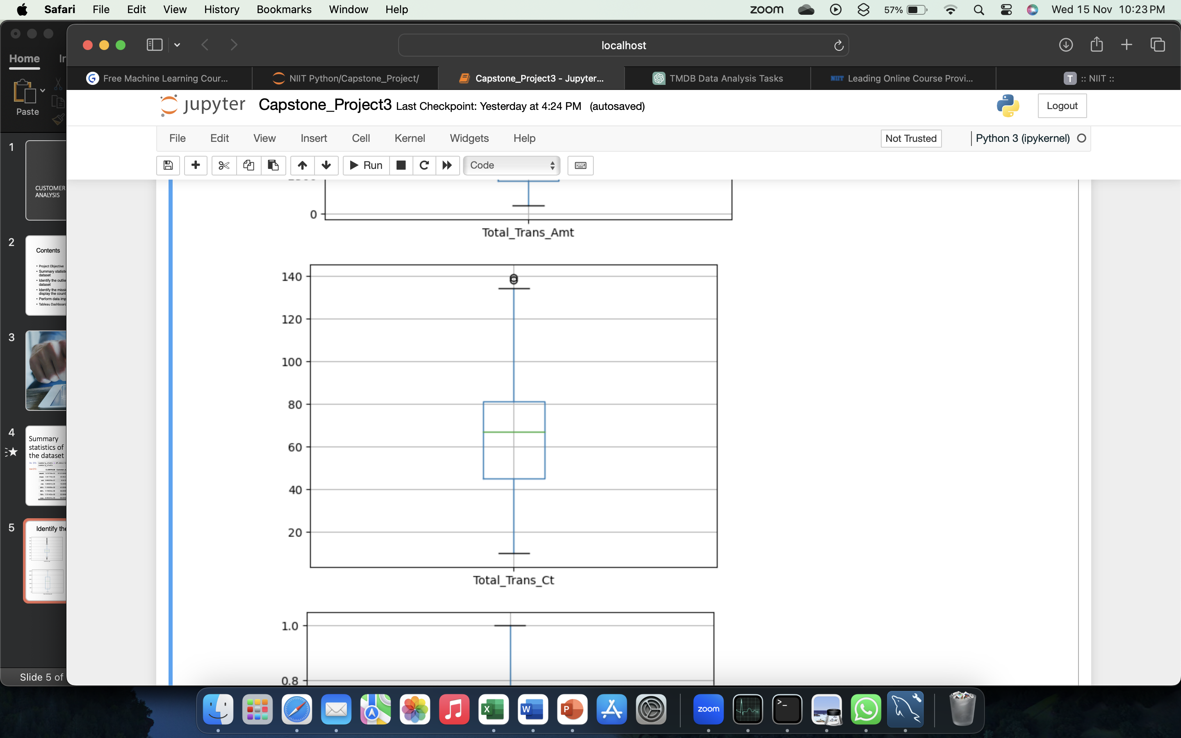

Identify the outliers in the dataset ﻿﻿

Slide 6
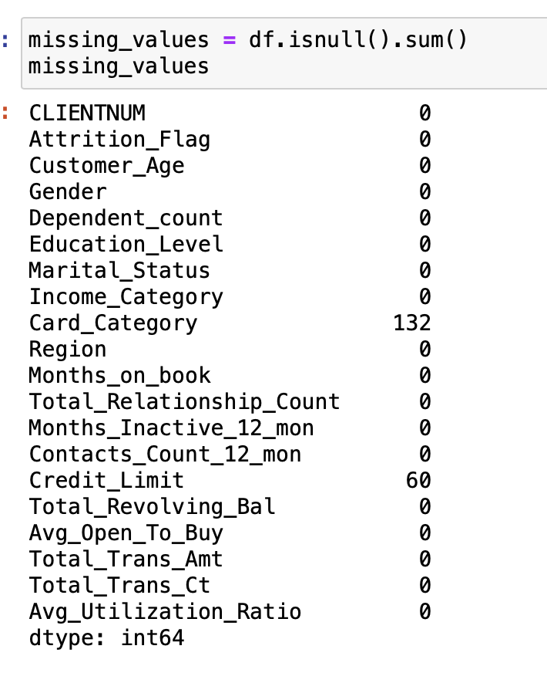
Identify the missing values and display the count ﻿﻿

Slide 7
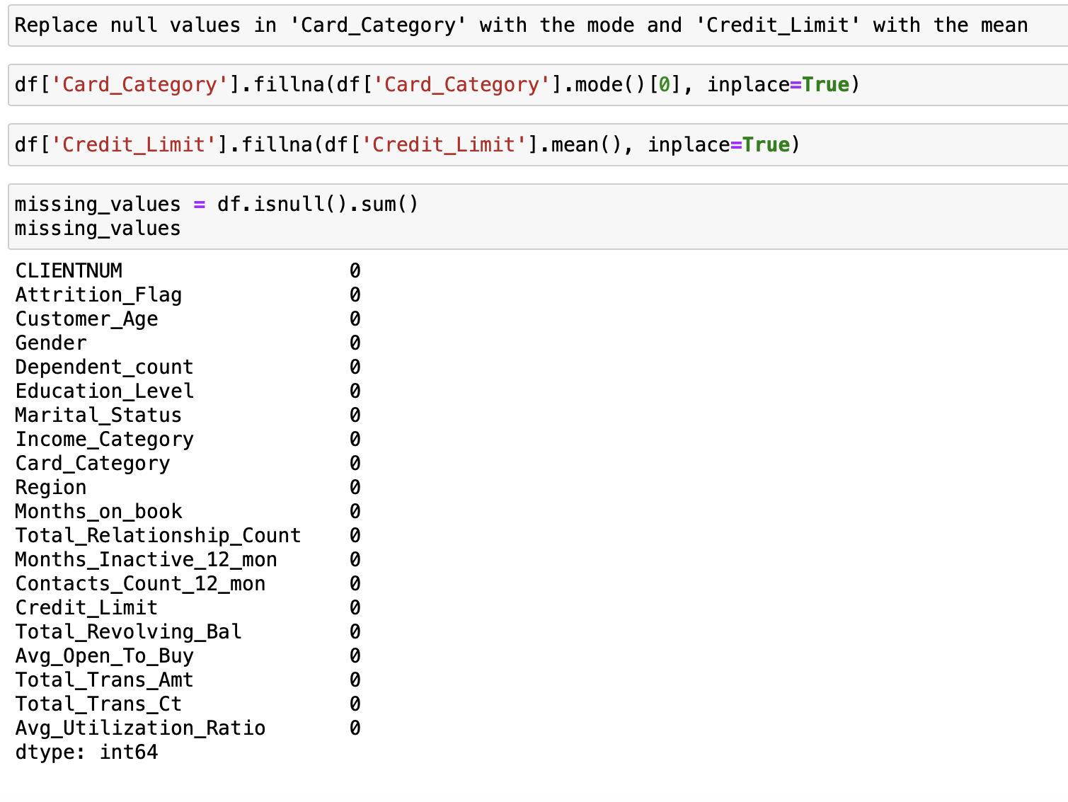
Data imputation

Slide 8

Tableau Dashboard

Slide 9
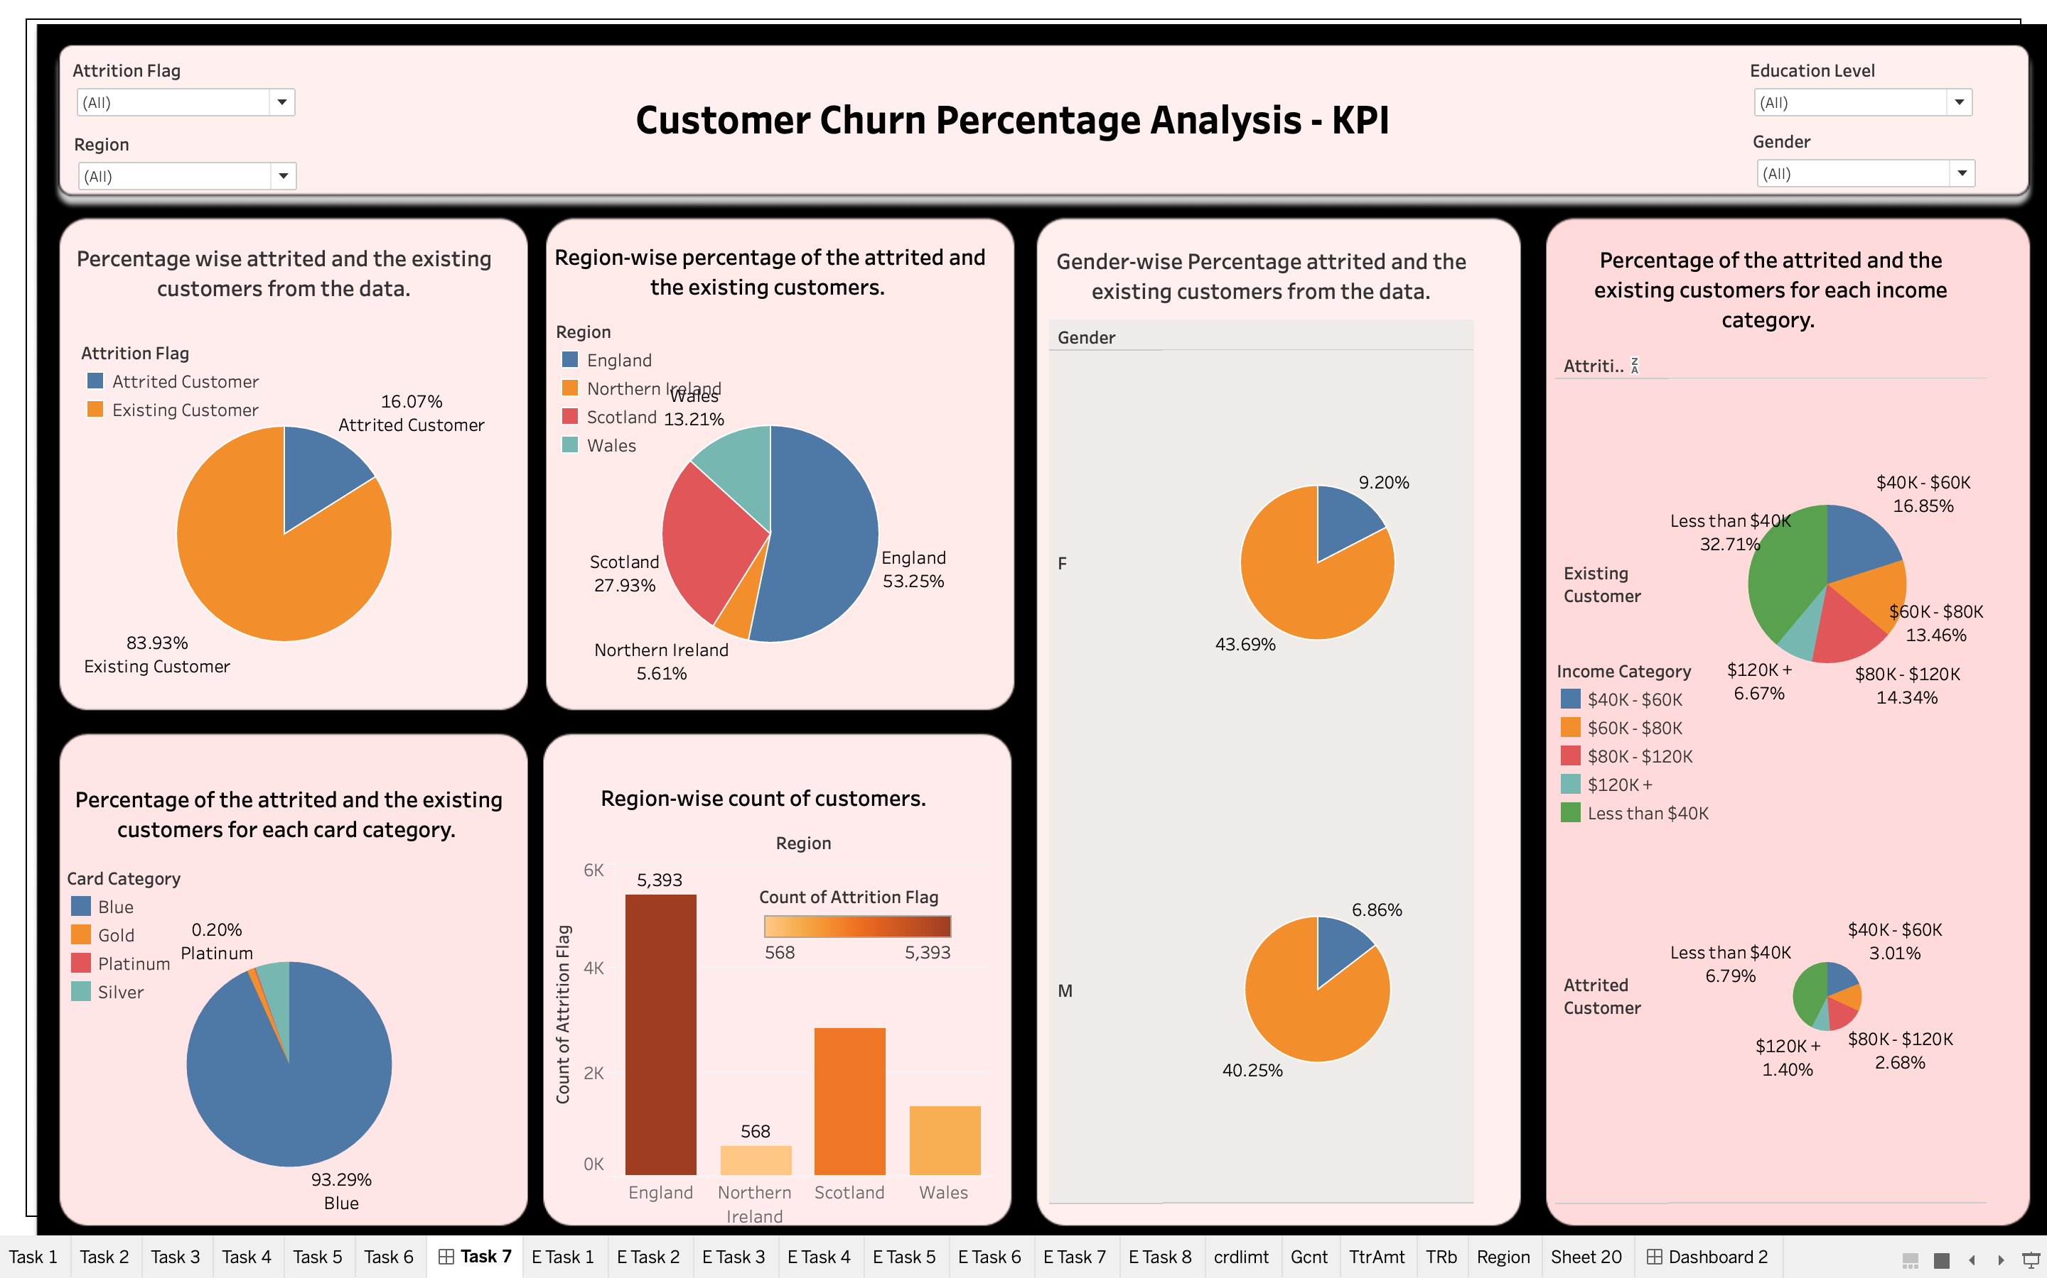

Slide 10
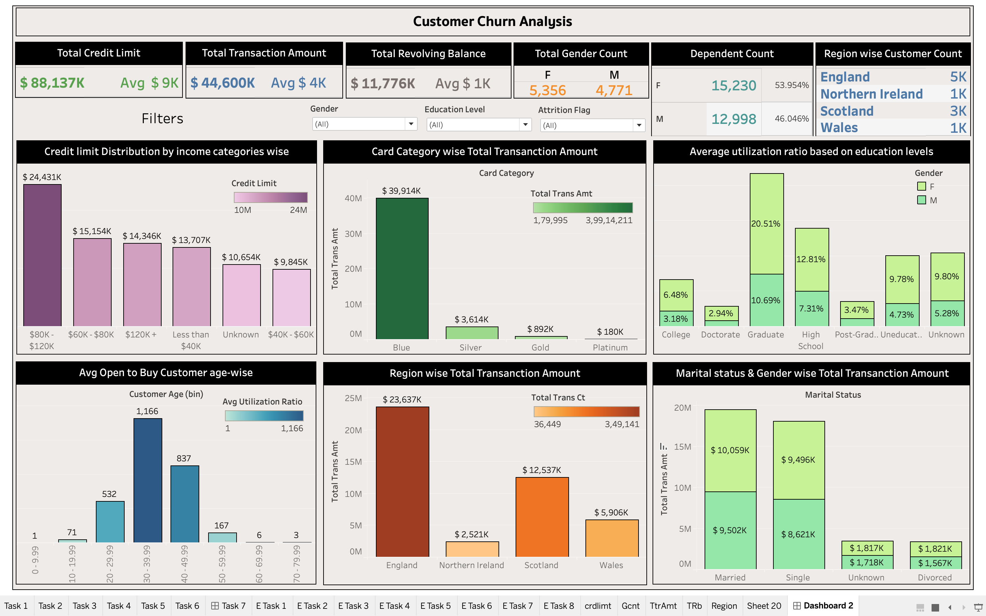

Slide 11

Conclusion
In this customer churn analysis for a North American bank's credit card business, various tasks were performed to gain insights into customer behaviour and inform strategies for reducing customer loss. The dataset included key features such as customer demographics, financial details, and transaction history.
The initial data pre-processing steps involved displaying summary statistics, identifying outliers, and handling missing values. Imputation methods were applied where appropriate, ensuring the dataset was ready for analysis.
Tableau was used to create insightful dashboard, addressing specific business questions.

Slide 12

Thank You

